Slide 1
Inspector F Maps Week 1: App Week 2: Paper map

Slide 2
Week 1: App

Slide 3
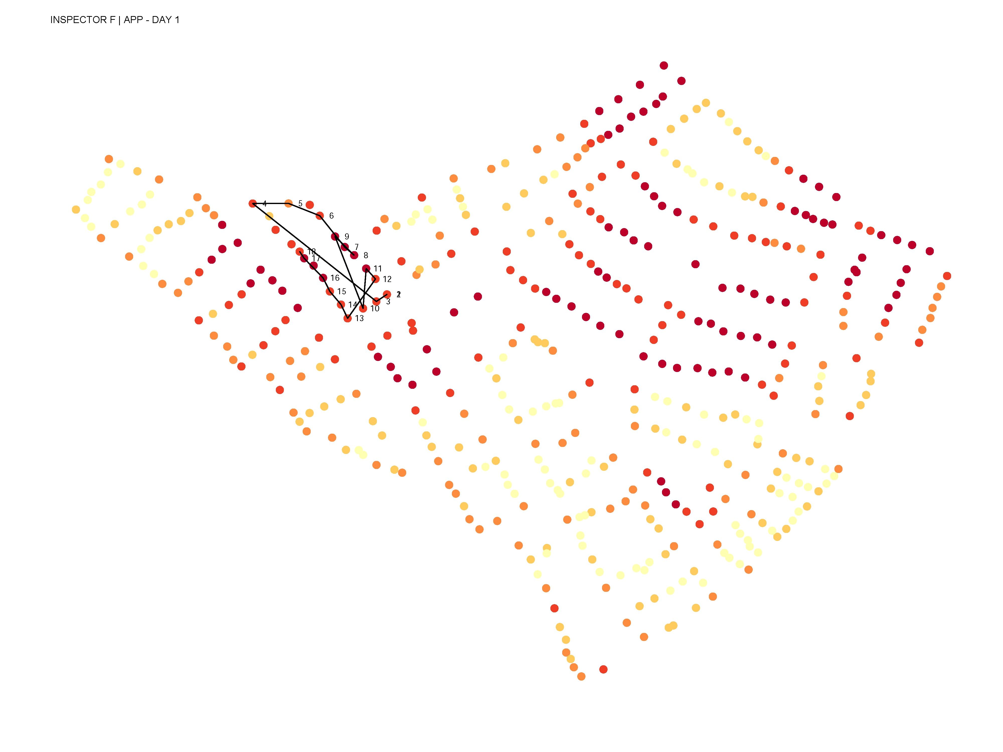
DAY 1 - APP

Slide 4
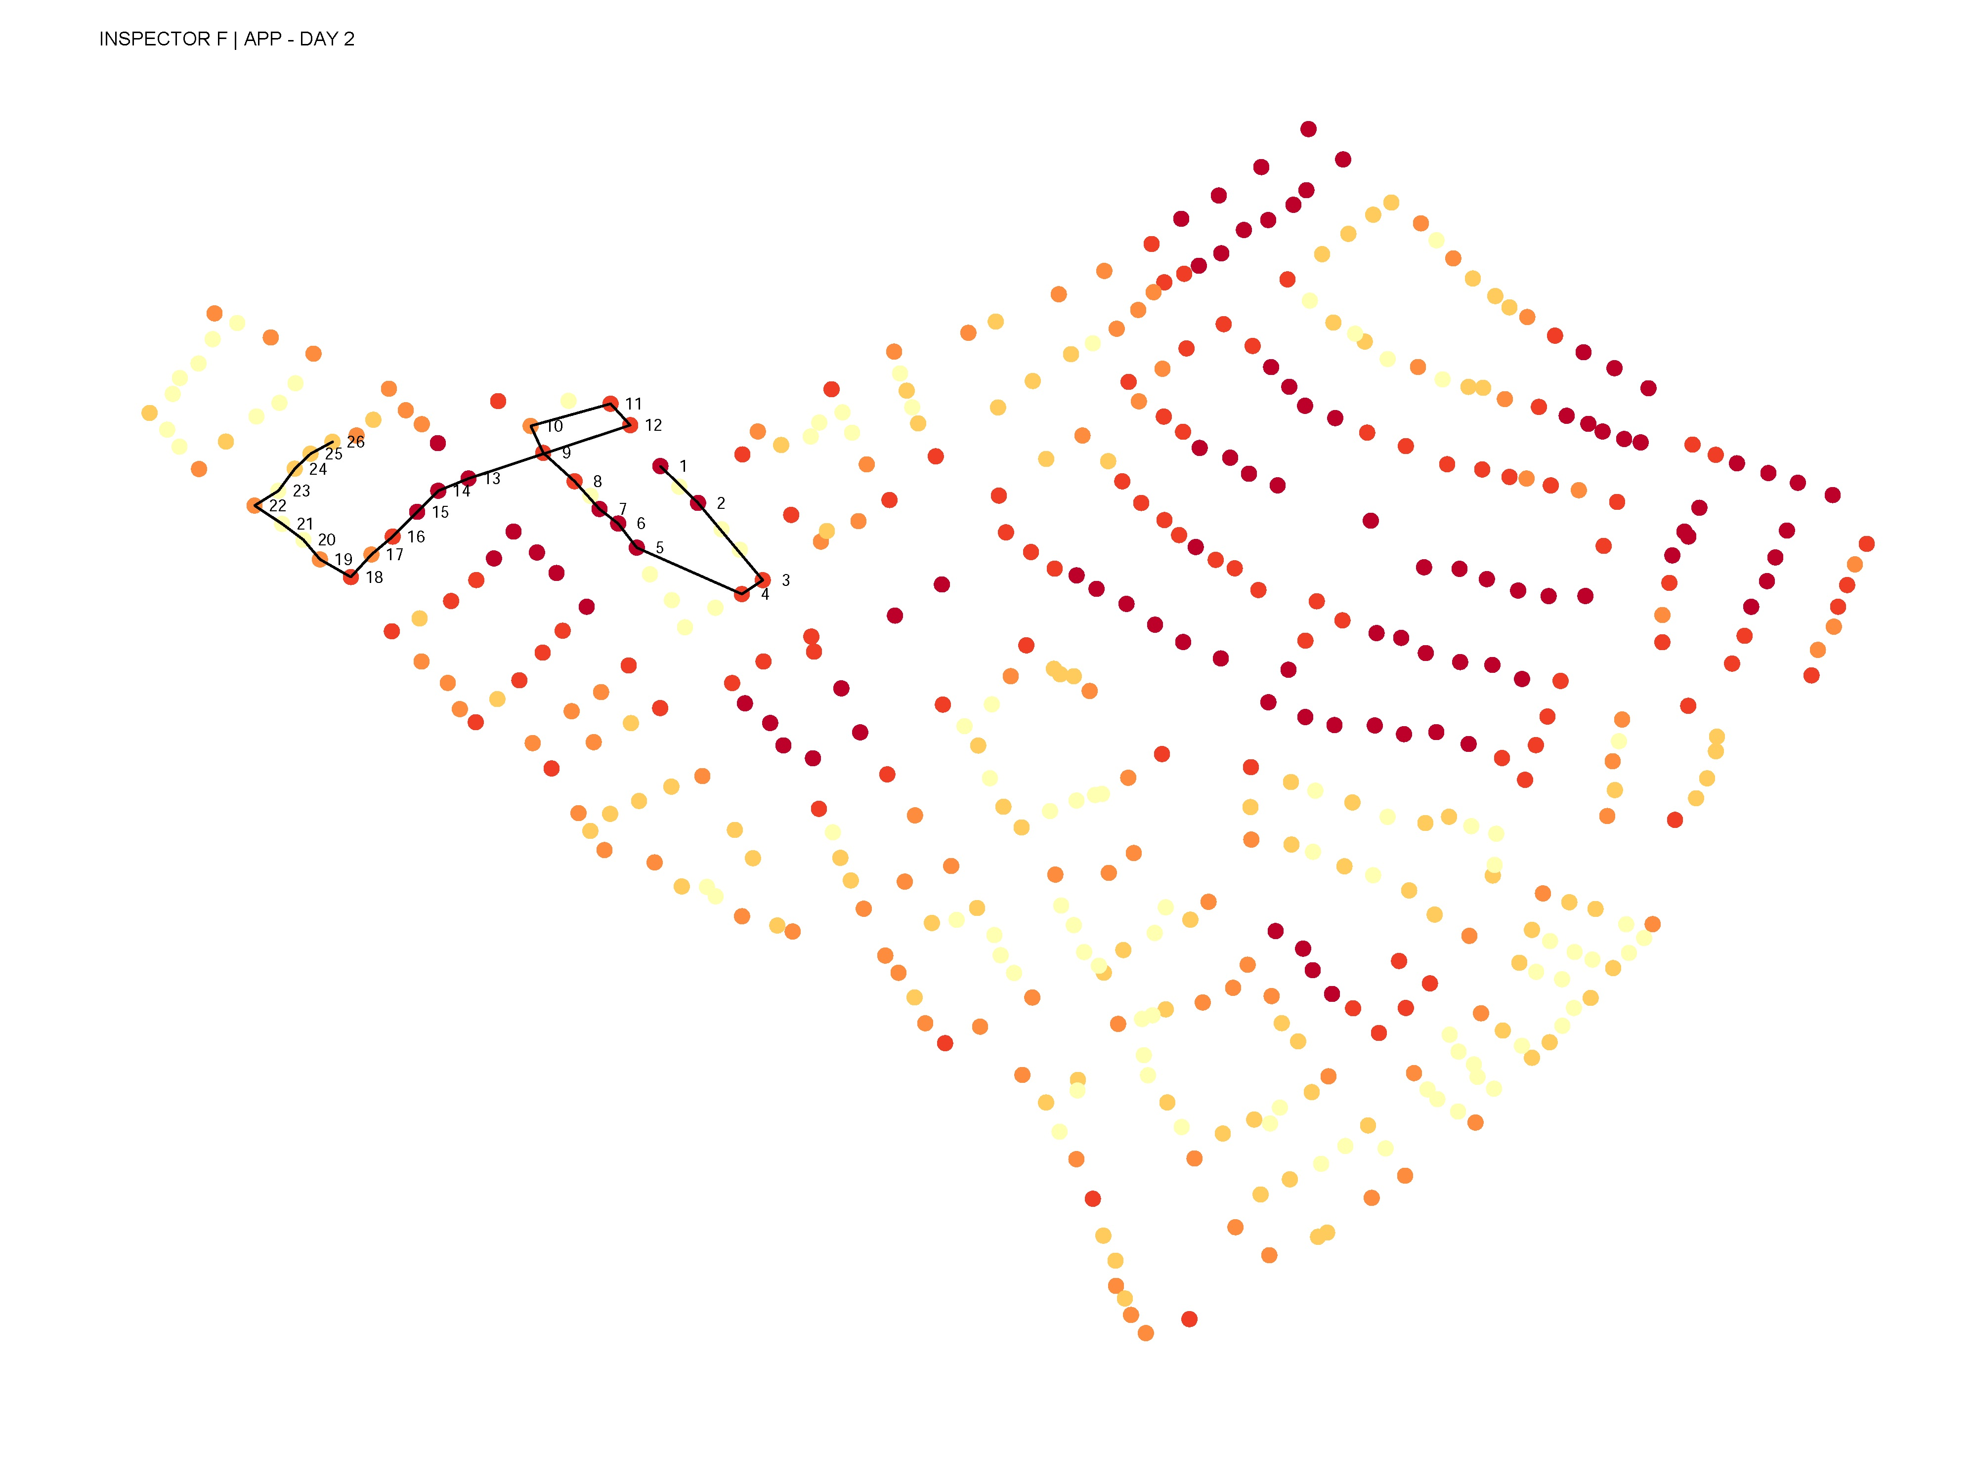
DAY 2 - APP

Slide 5
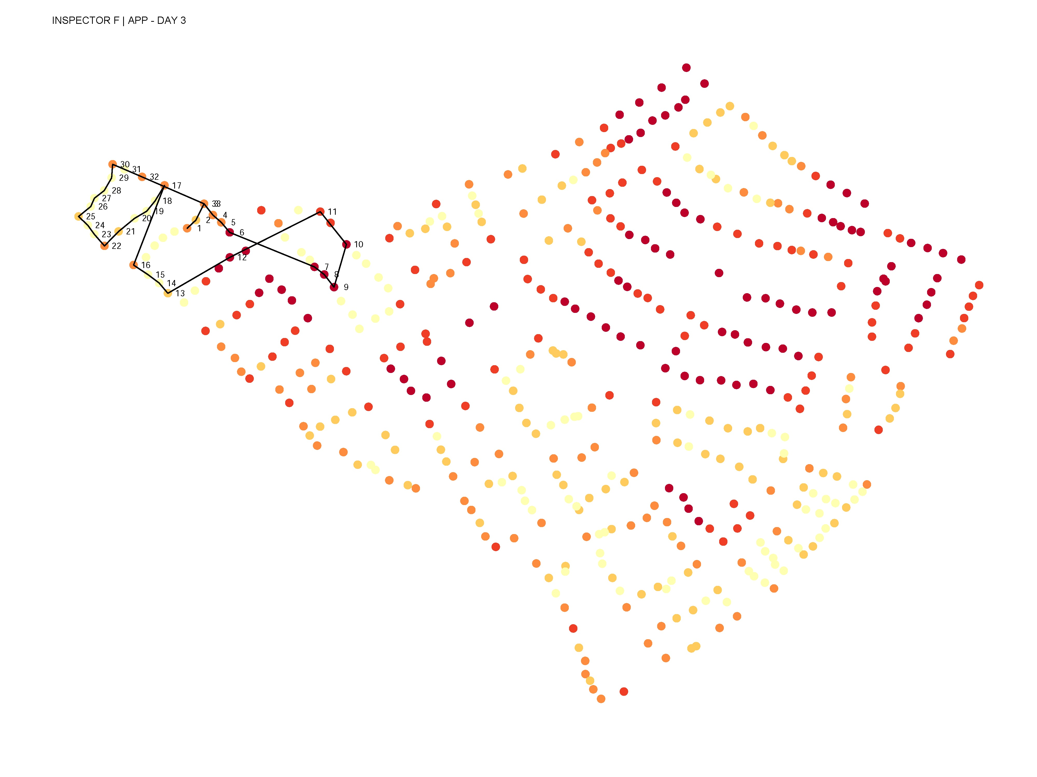
DAY 3 - APP

Slide 6
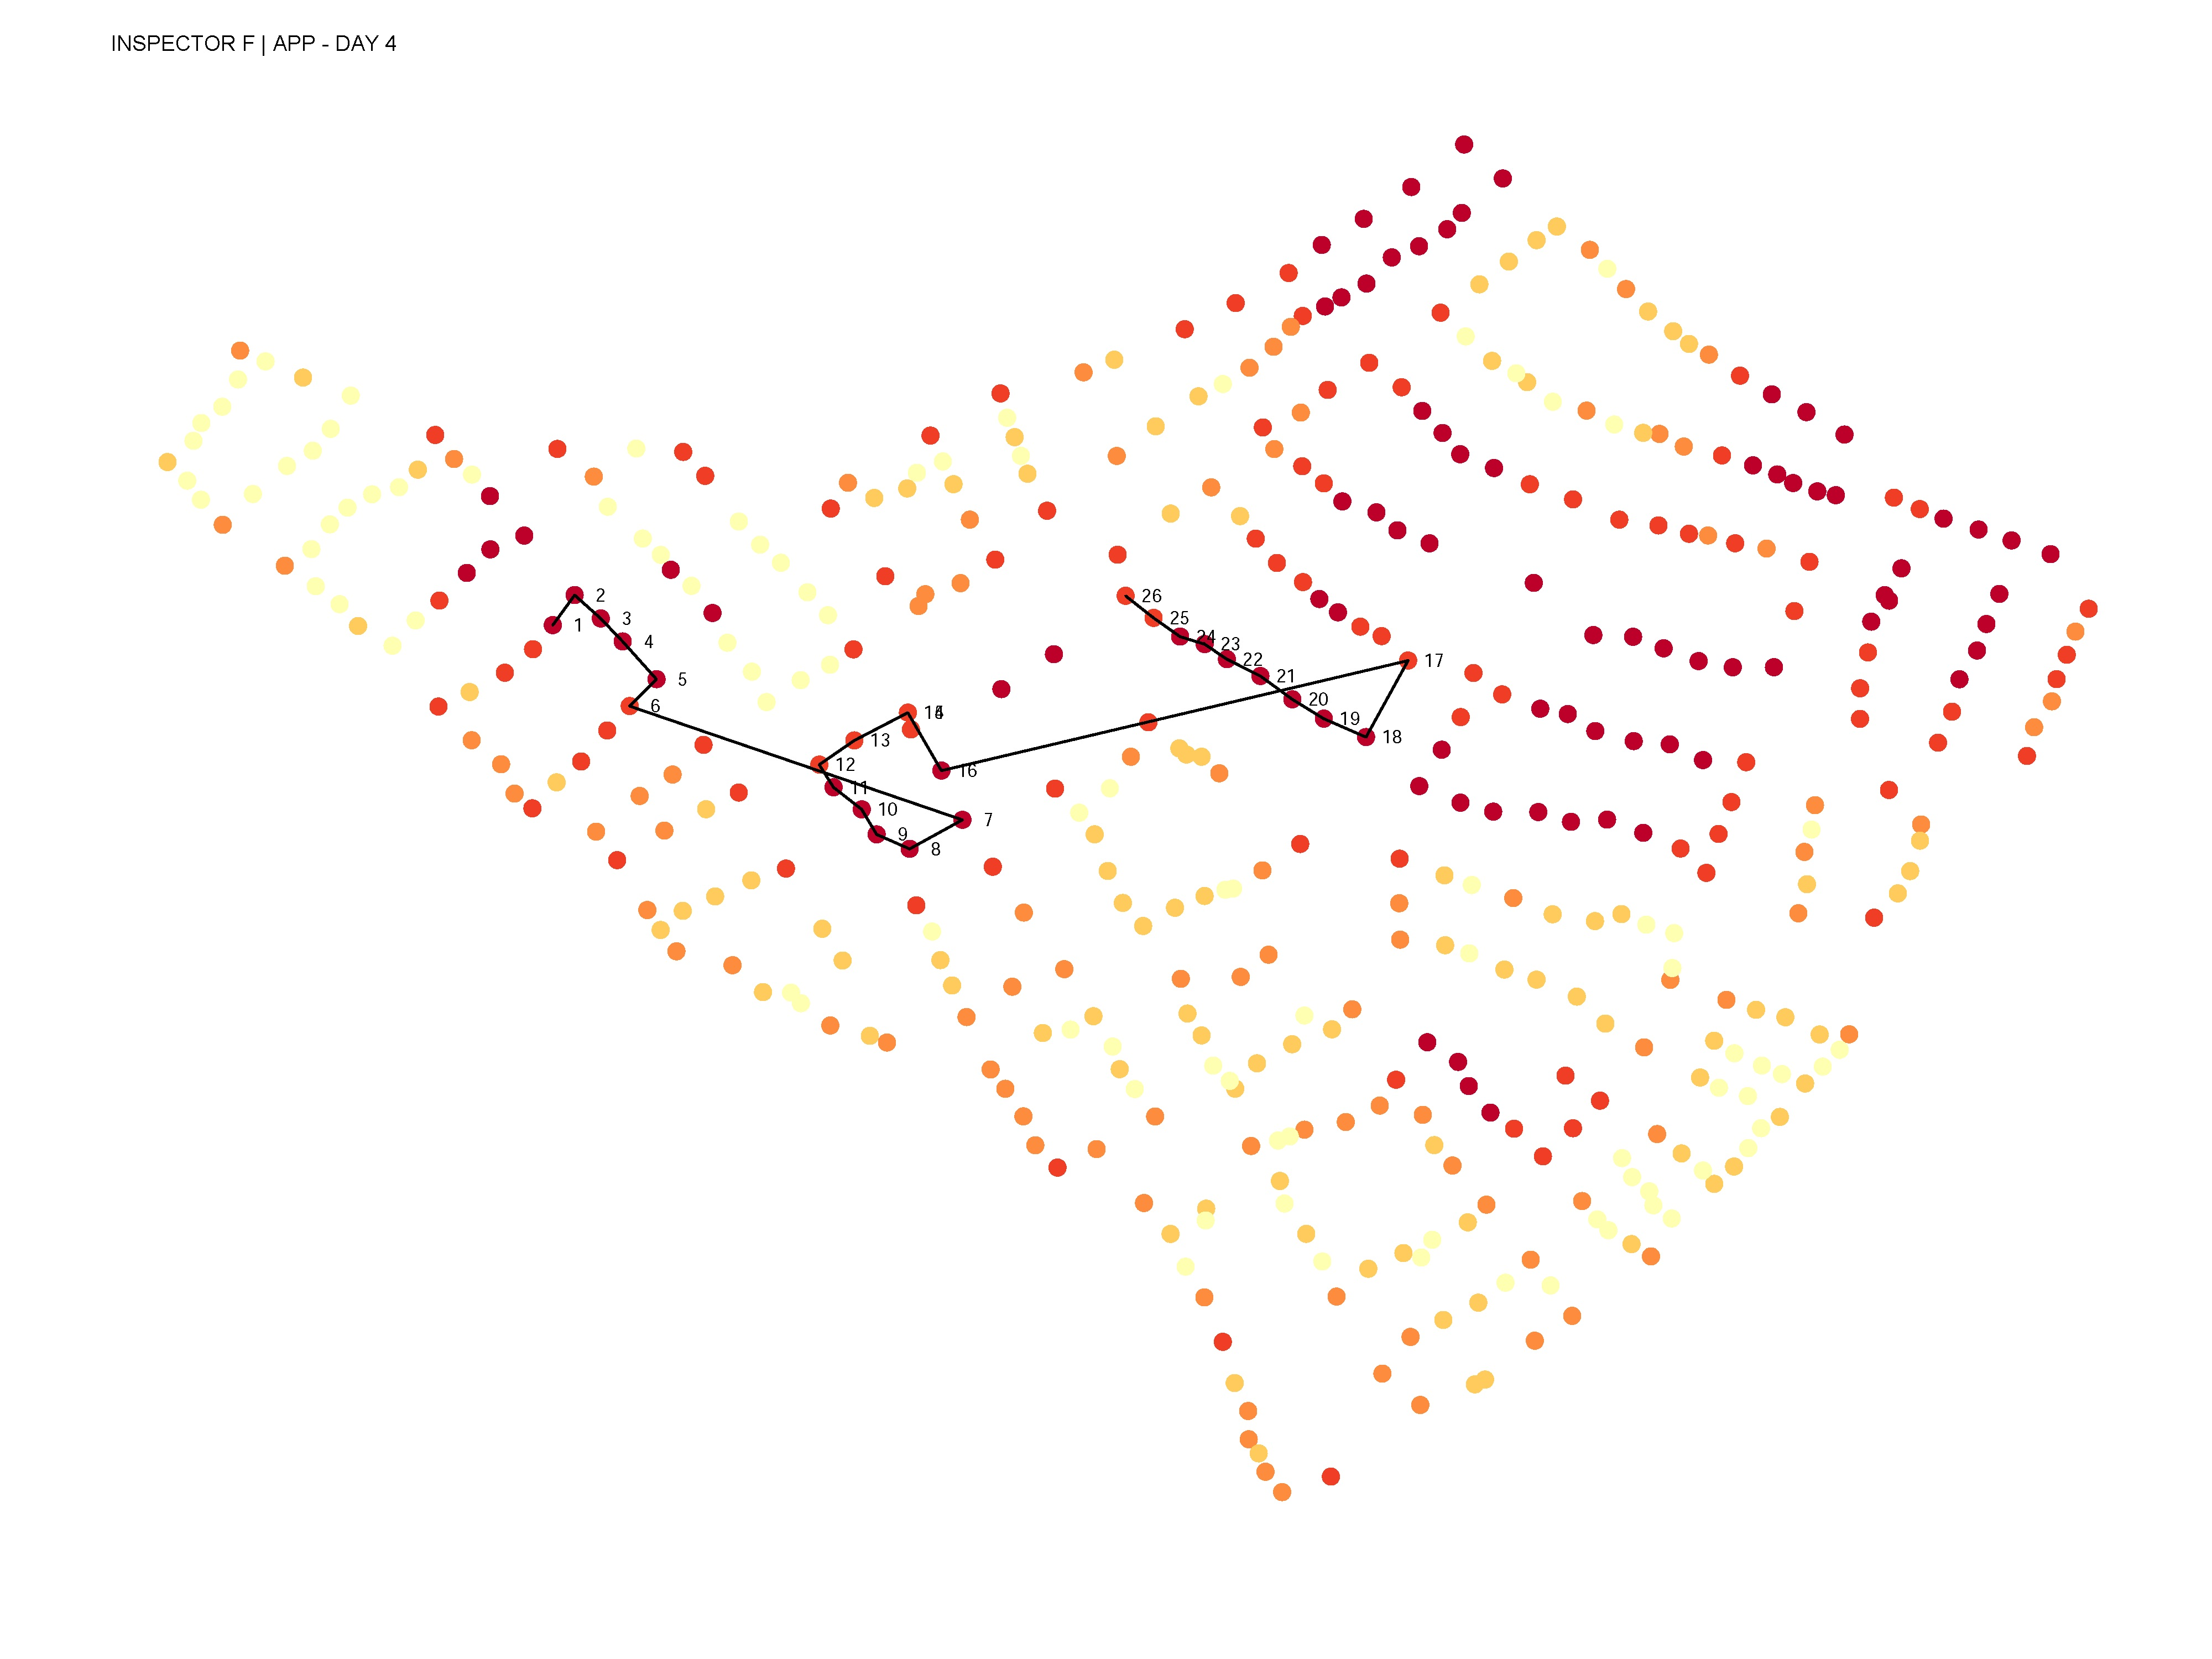
DAY 4 - APP

Slide 7
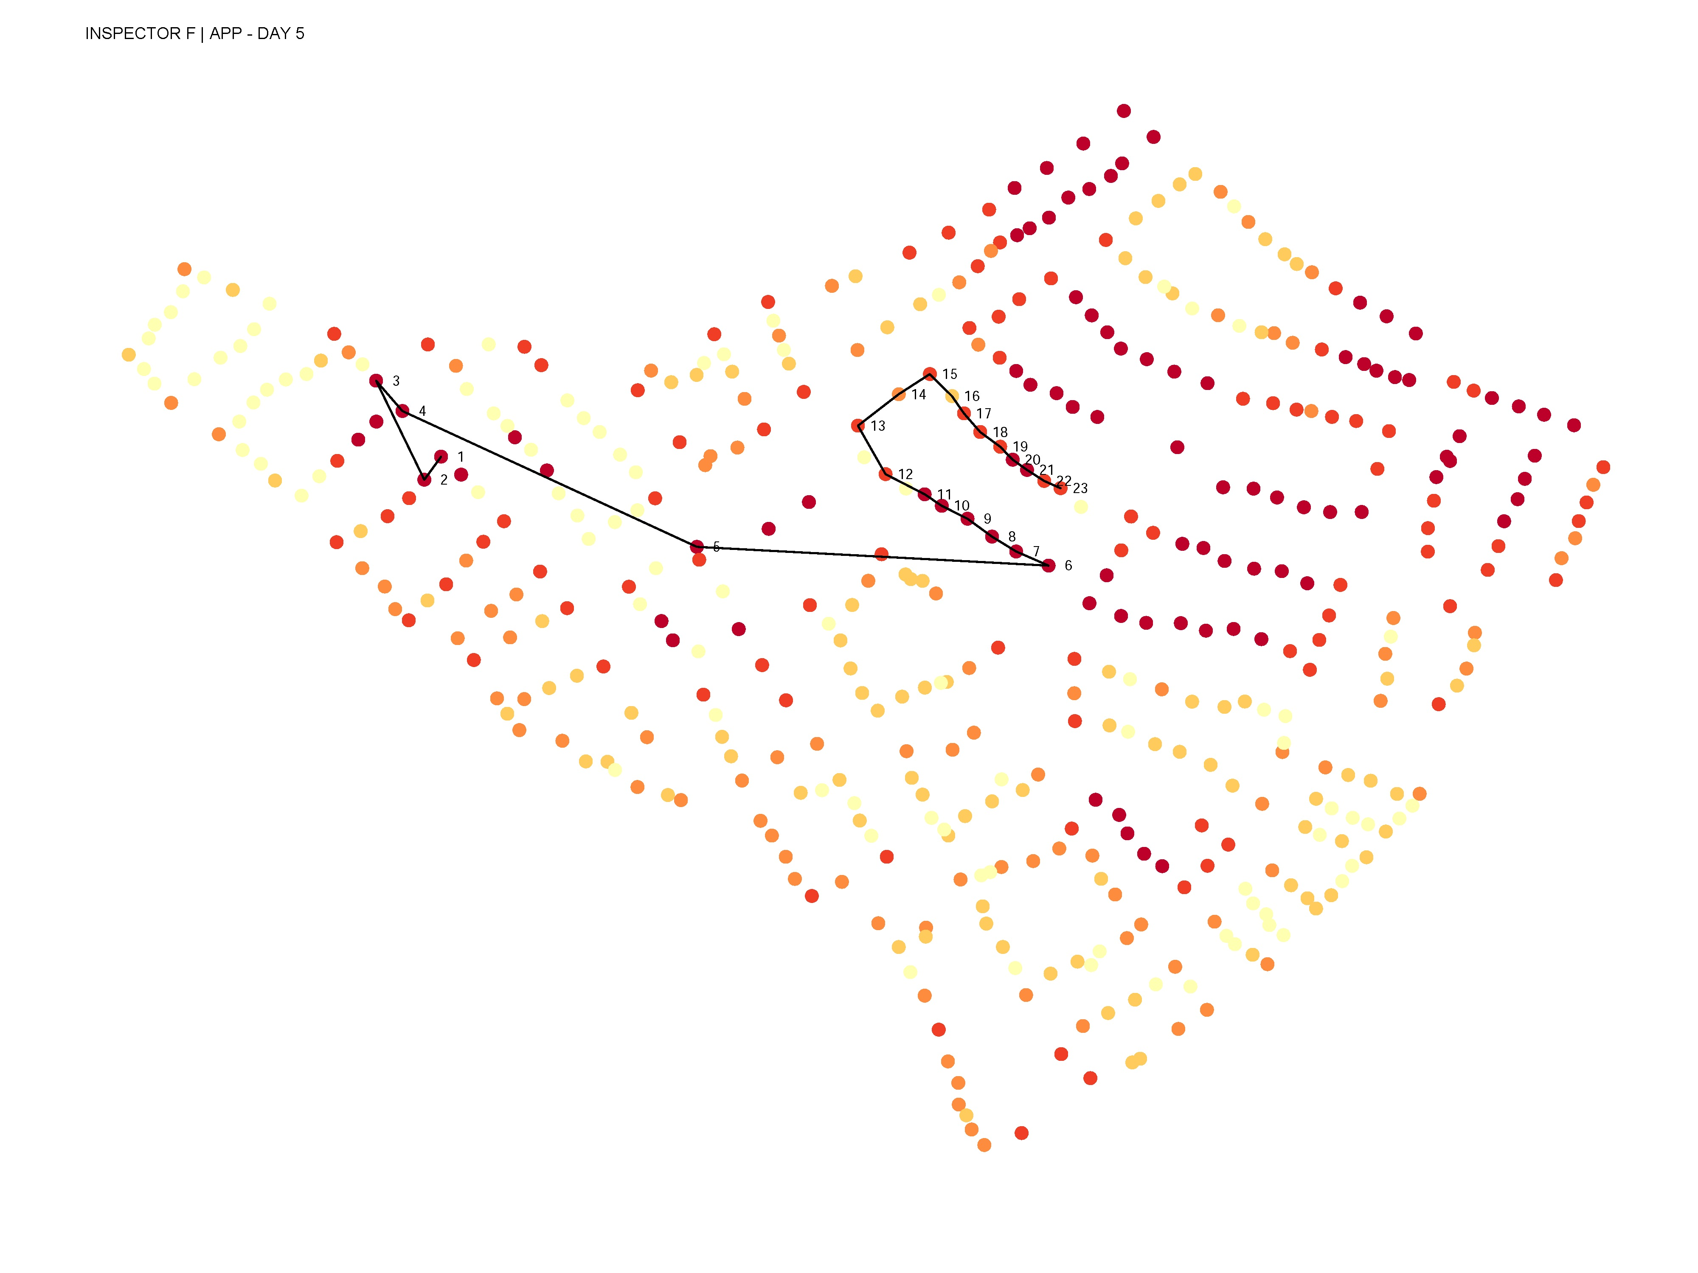
DAY 5 - APP

Slide 8
Week 2: Paper map

Slide 9
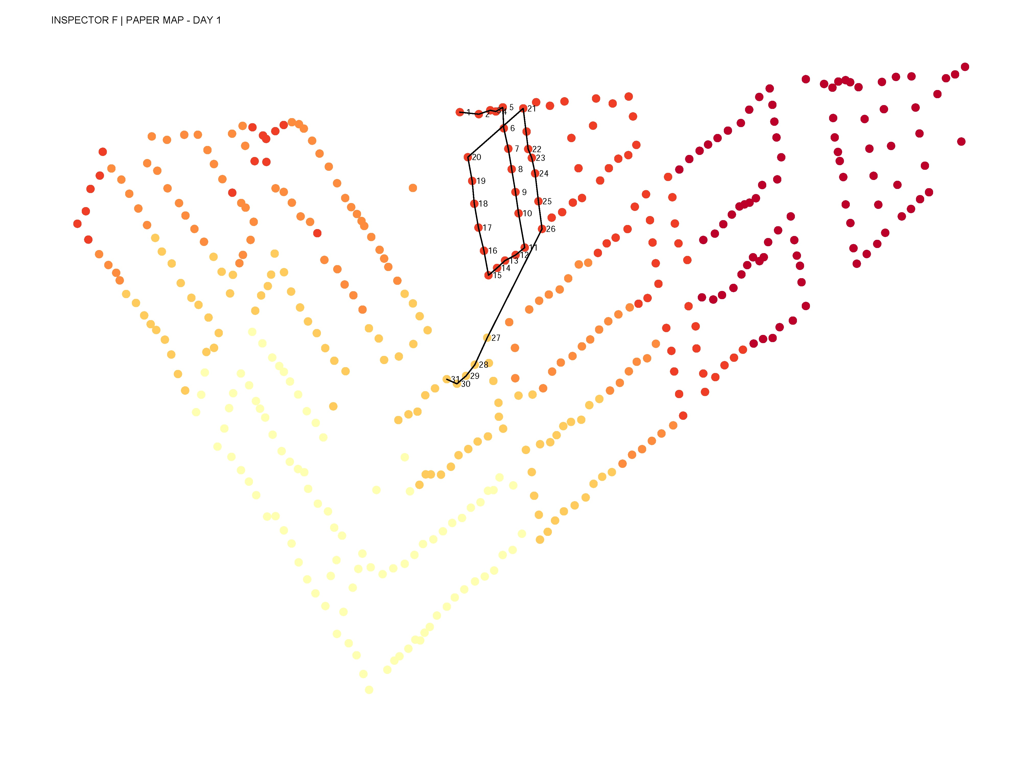
DAY 1 – PAPER MAP

Slide 10
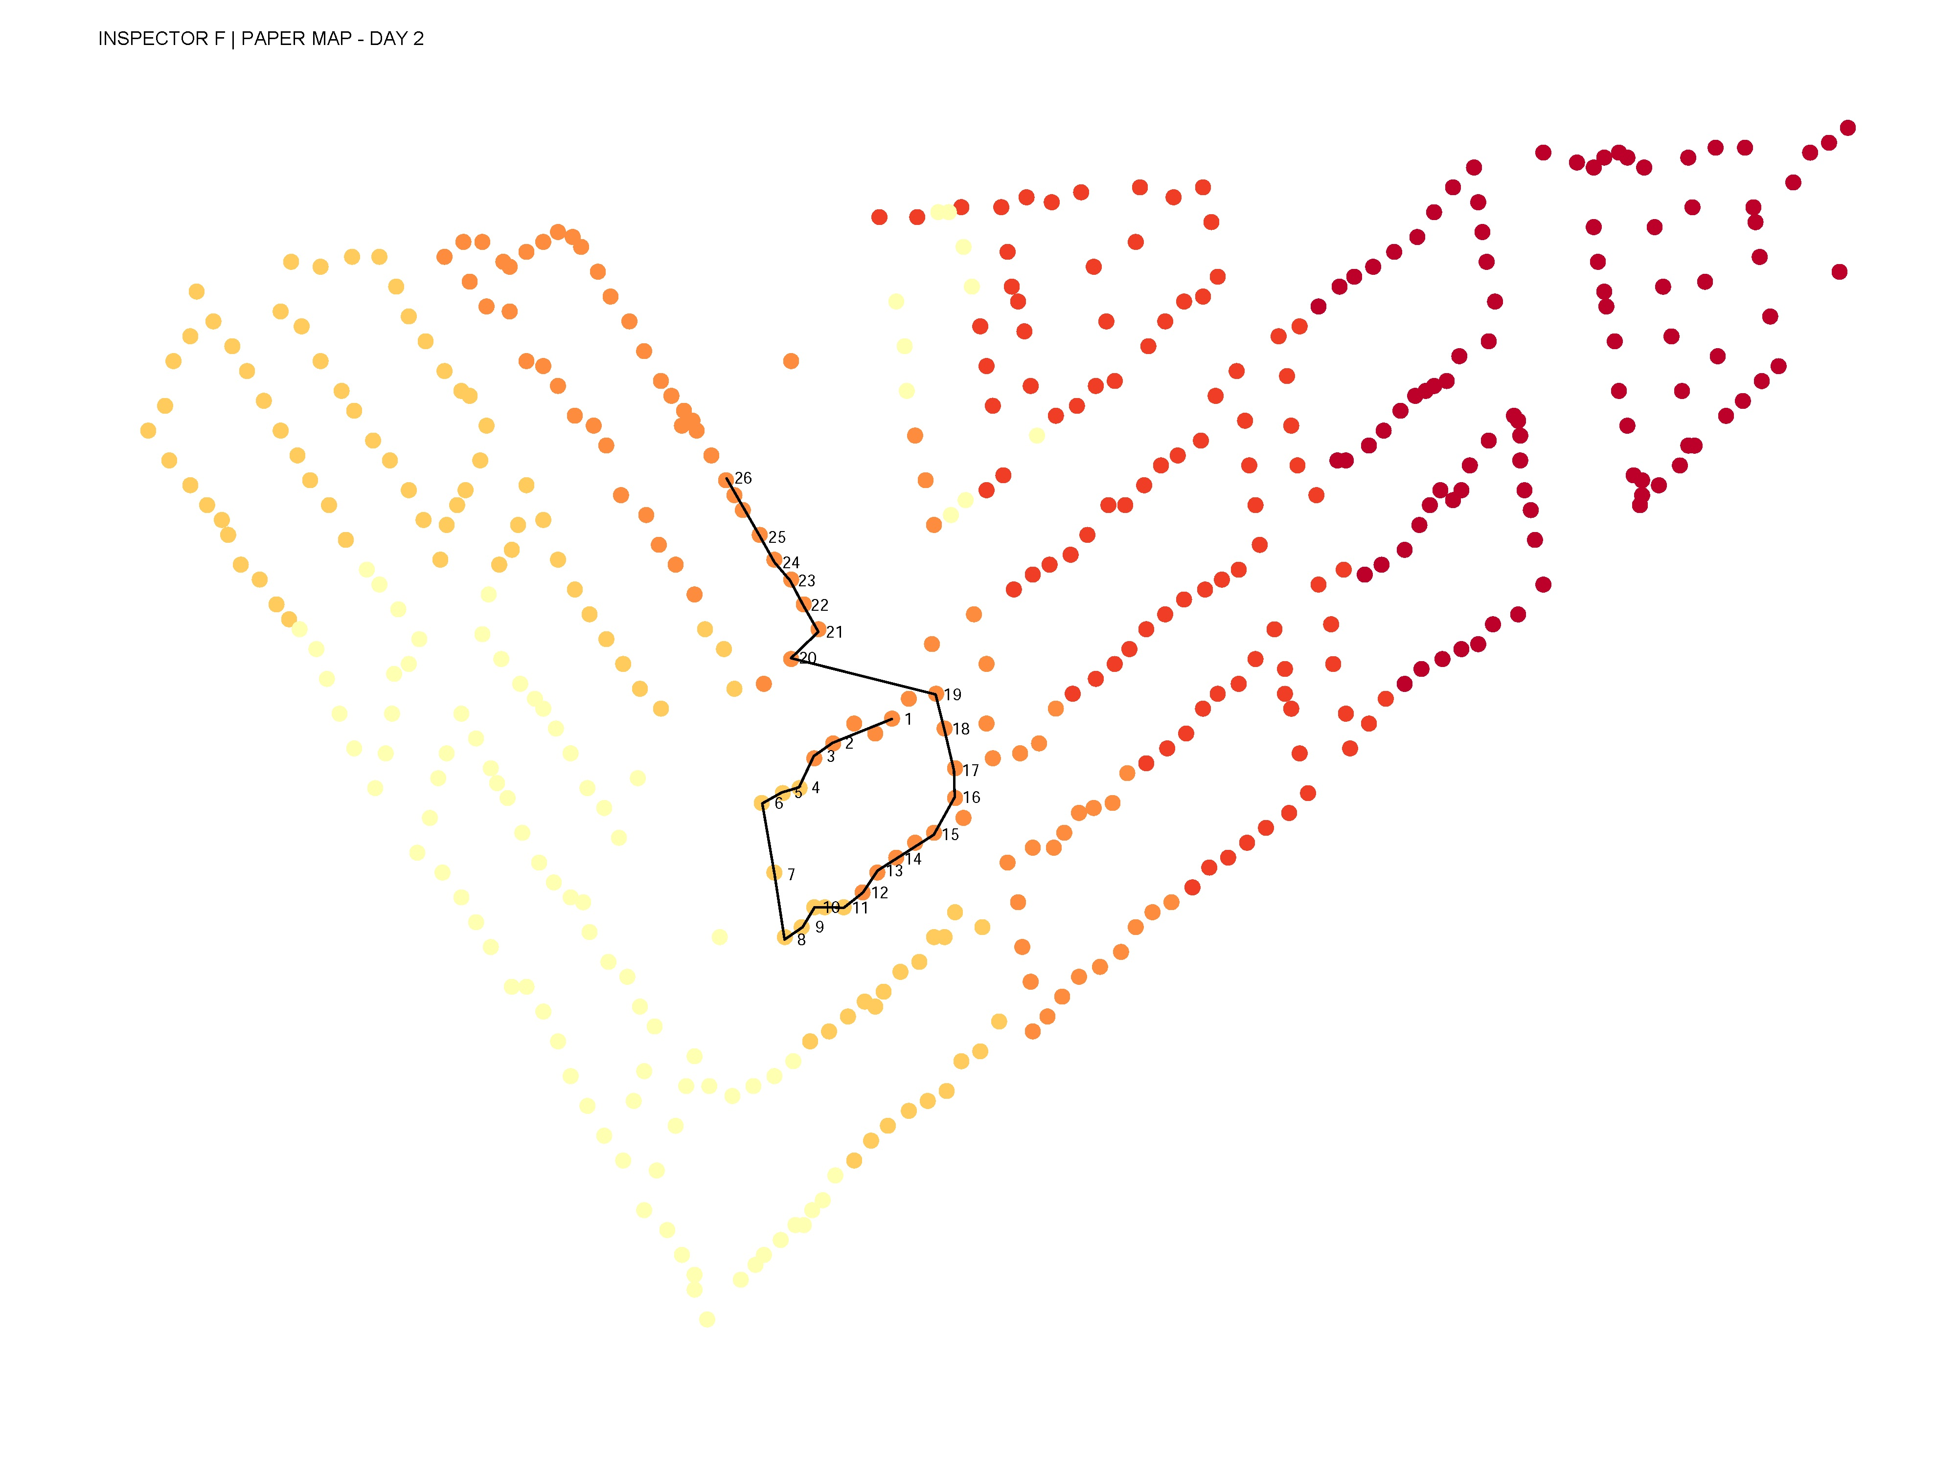
DAY 2 – PAPER MAP

Slide 11
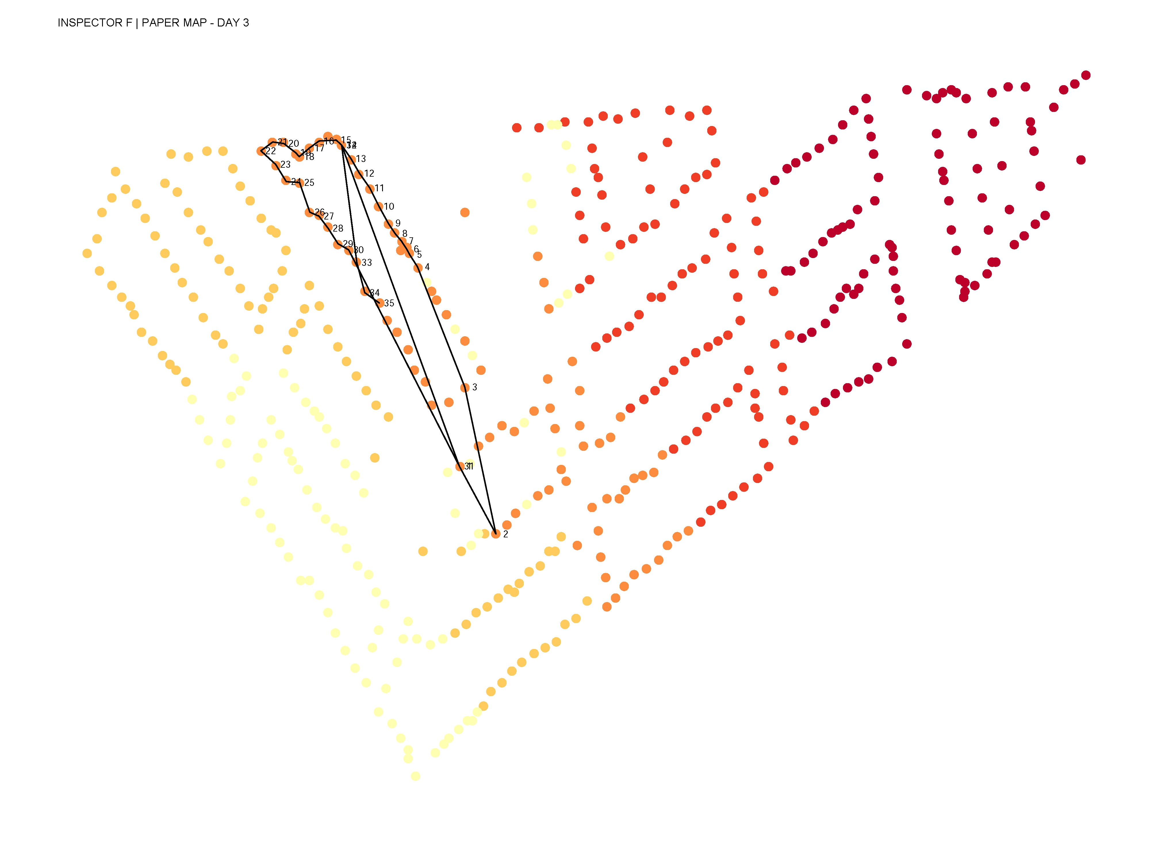
DAY 3 – PAPER MAP

Slide 12
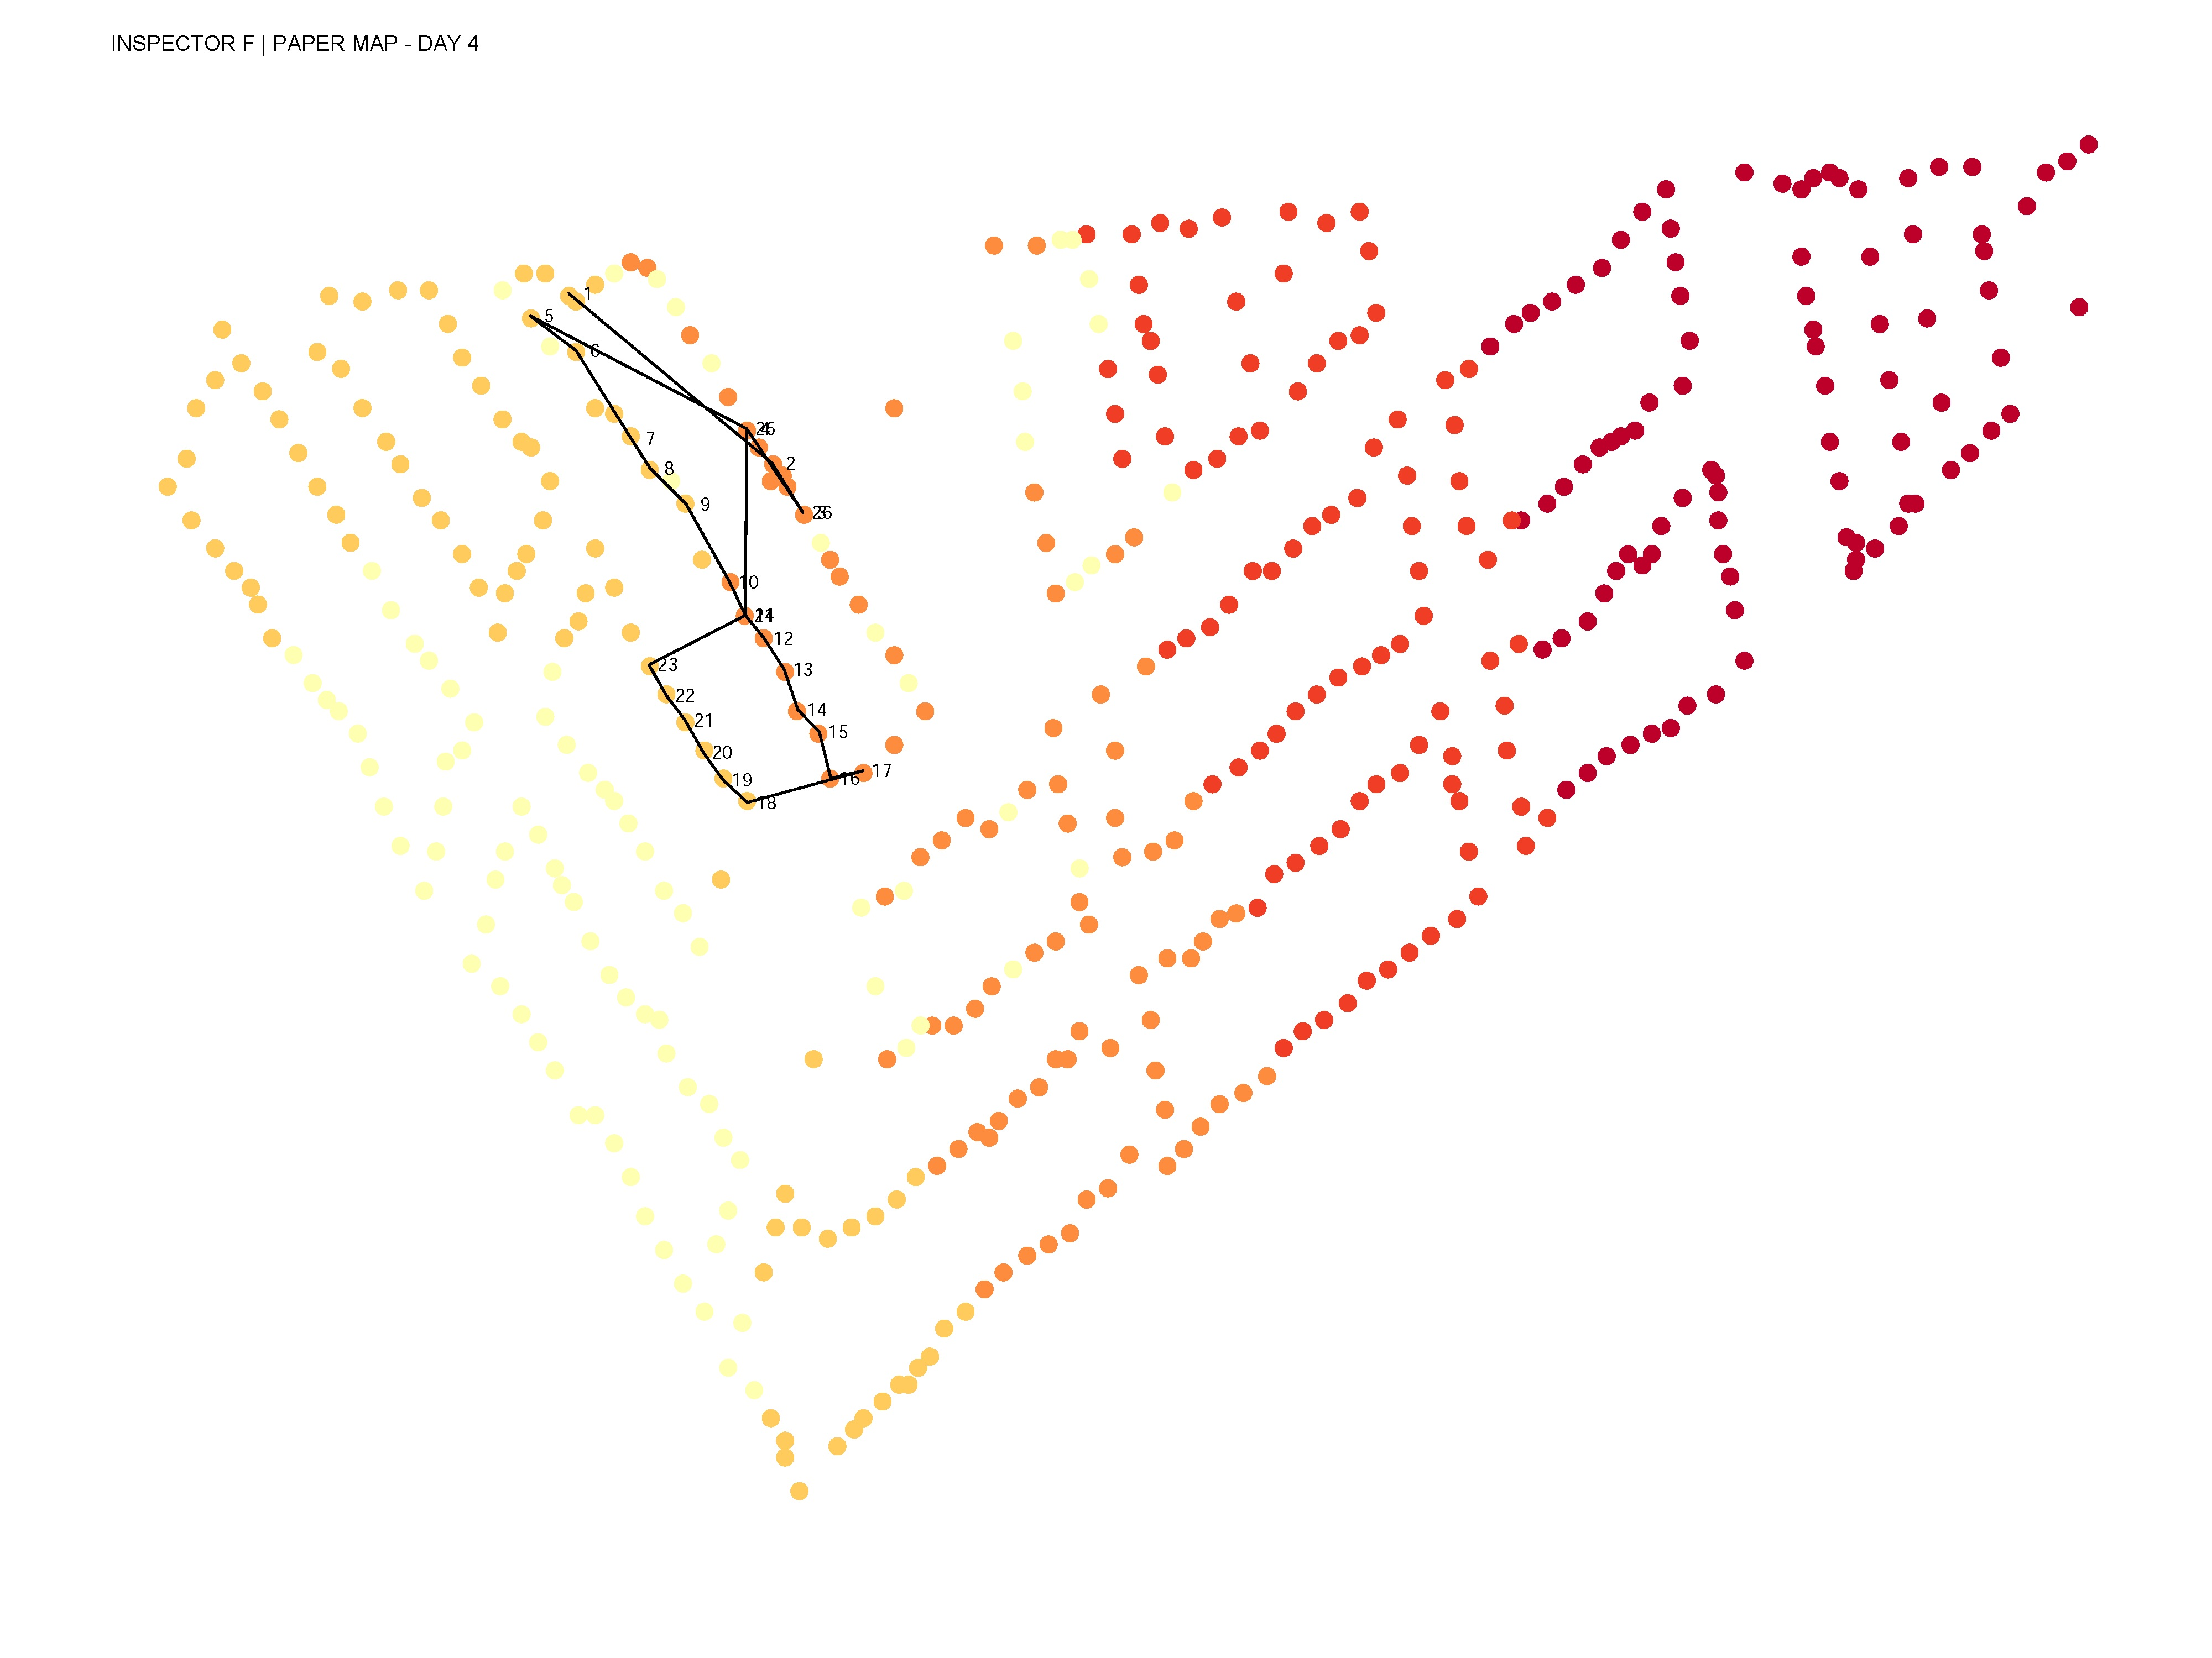
DAY 4 – PAPER MAP

Slide 13
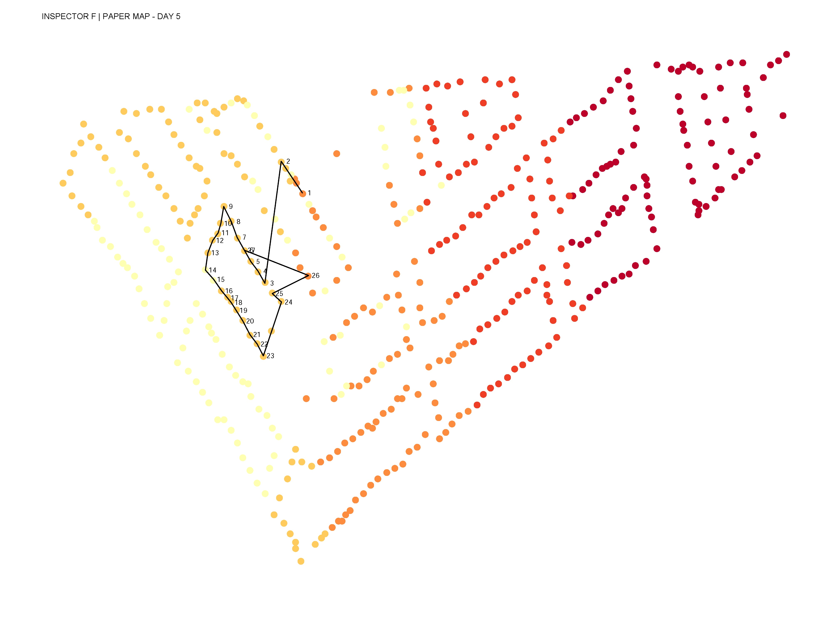
DAY 5 – PAPER MAP

